Slide 1


Slide 2
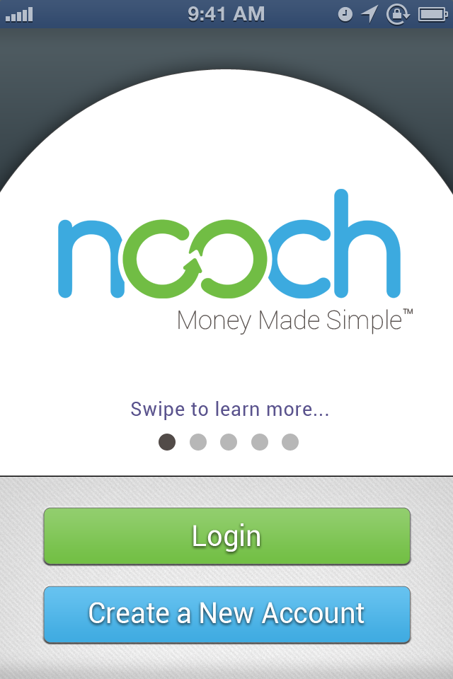

Slide 3
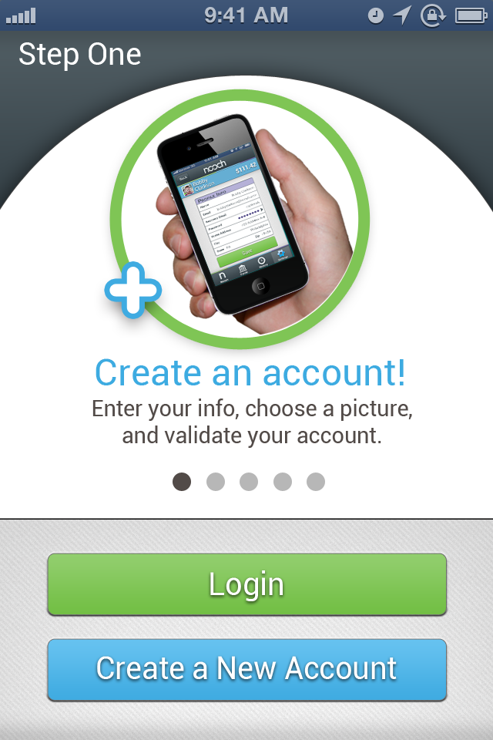

Slide 4
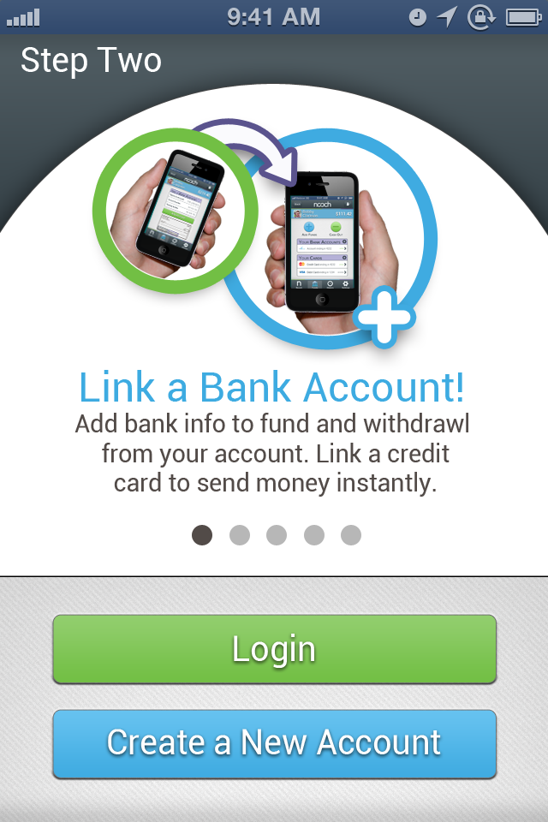

Slide 5
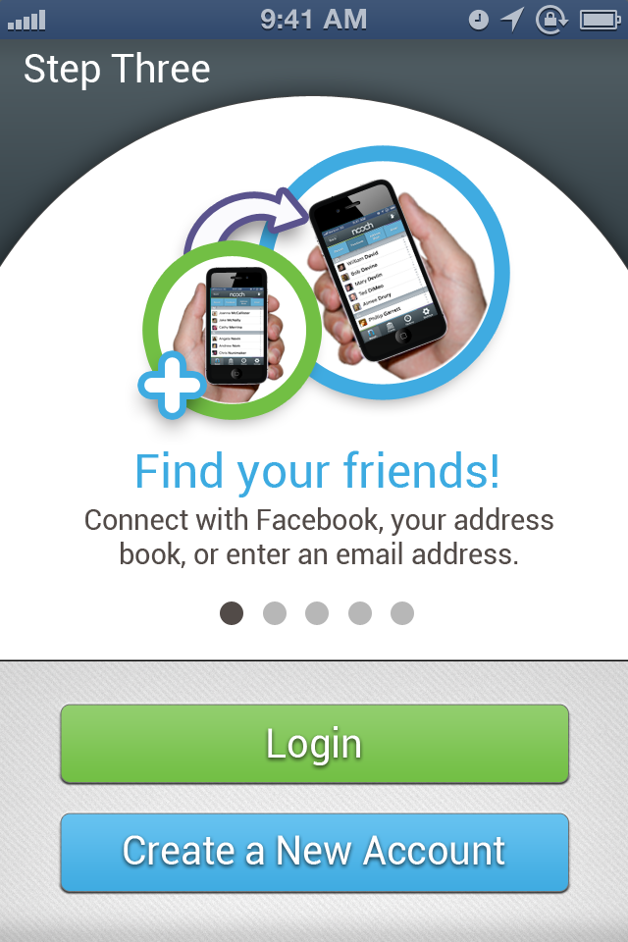

Slide 6
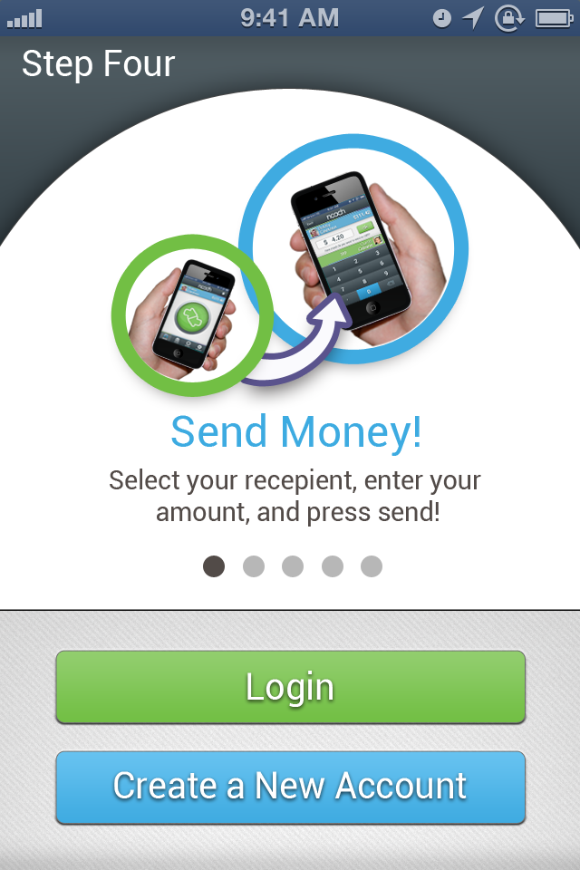

Slide 7
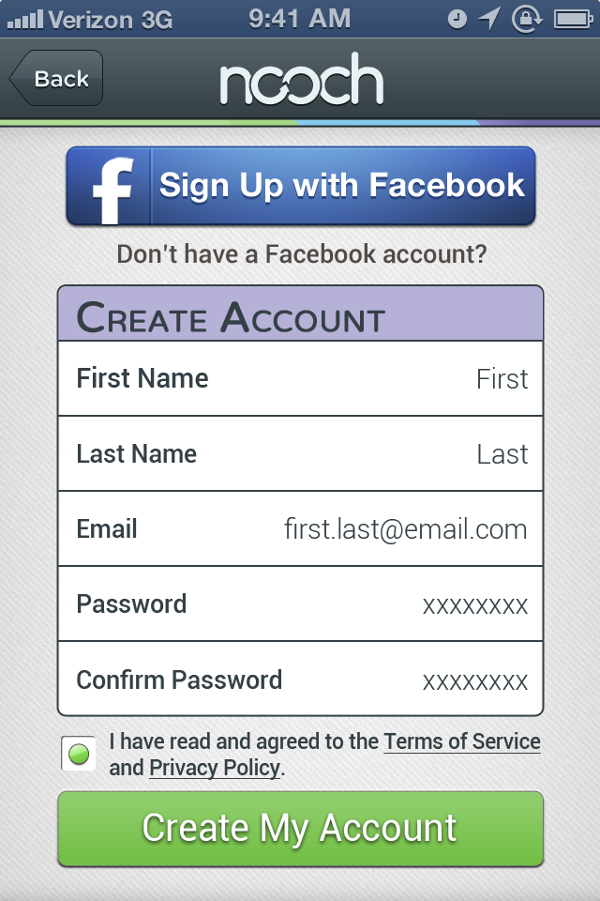
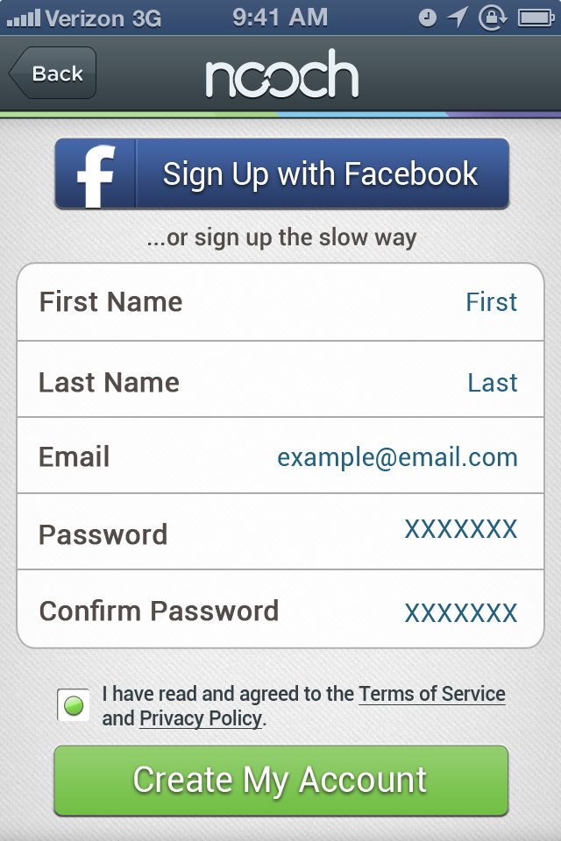
FB Connect: upon successful validation, return to this screen with the First/Last name and Email pre-filled out
Roboto, size 6, grey
Roboto, size 7, bold
Roboto, size 6.5, regular
Color =
R: 36 G: 97 B: 127
Make these blue circles instead of X’s.
ToS and Privacy Policy link to new screen that pulls the most recent version from web server.
Roboto, size 5

Slide 8
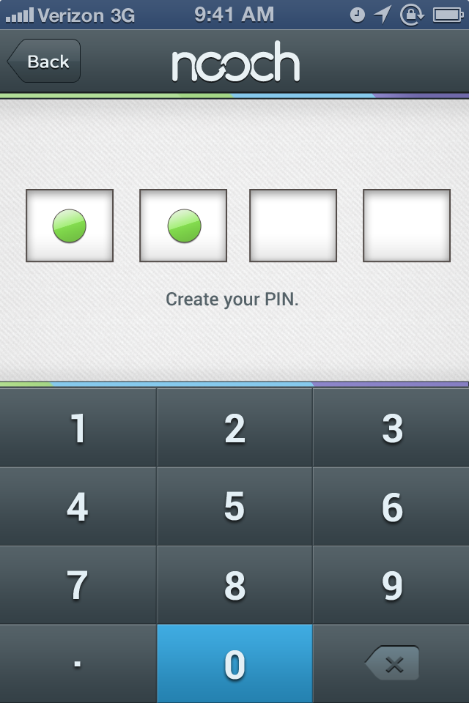
User must enter PIN twice to create it… the 2nd time, the text should say: “Confirm your PIN.” After successfully entering twice, go to Home Screen.
No Period on any PIN screen

Slide 10
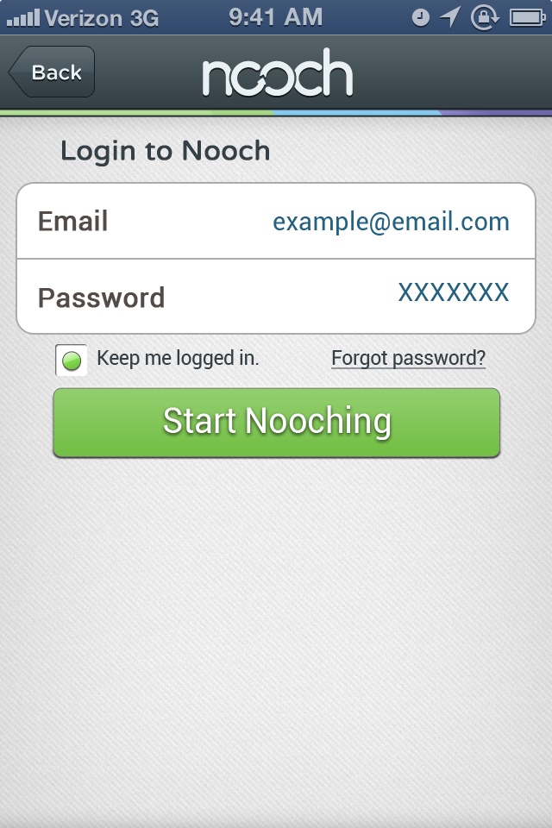
Varela Round, Size 7, Bold
Roboto, size 5, regular
Roboto, size 9, regular

Slide 11
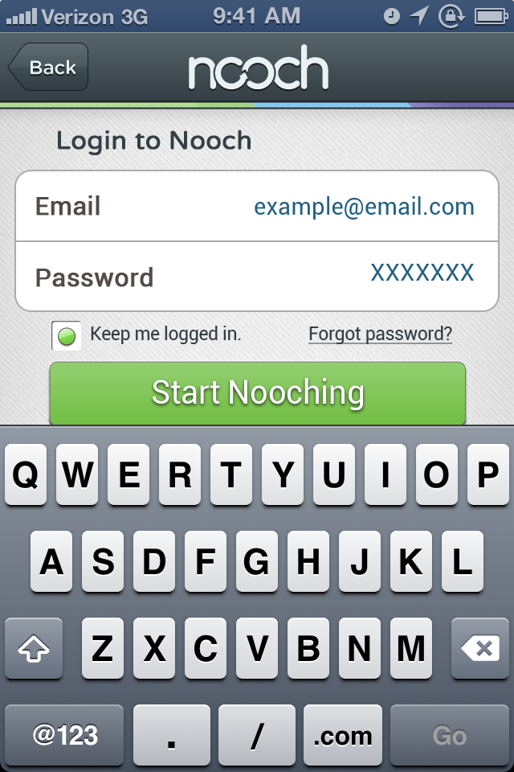

Slide 12
Send Money Flow

Slide 13
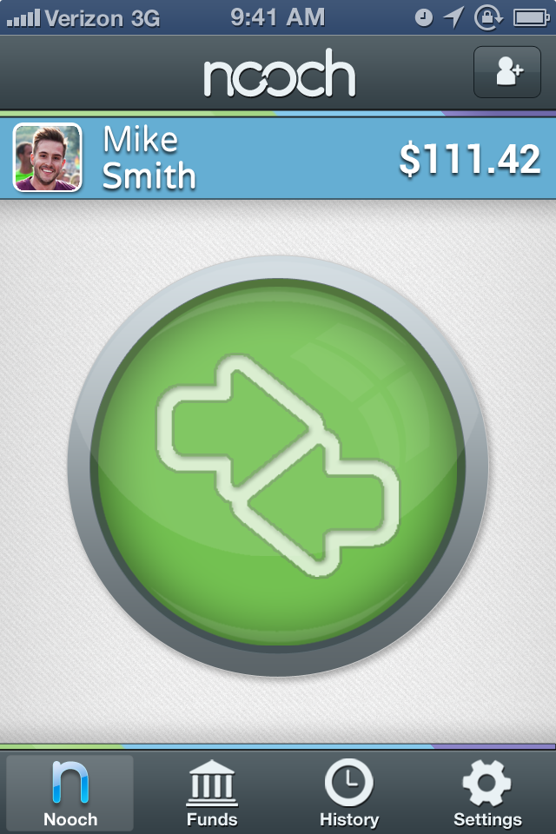
Tapping the picture OR the name (so basically the left half of the blue bar) takes you to the PROFILE screen (within settings)
Invite Button (should resemble the “select account screen)
Tapping the balance takes you to the FUNDS screen.

Slide 14
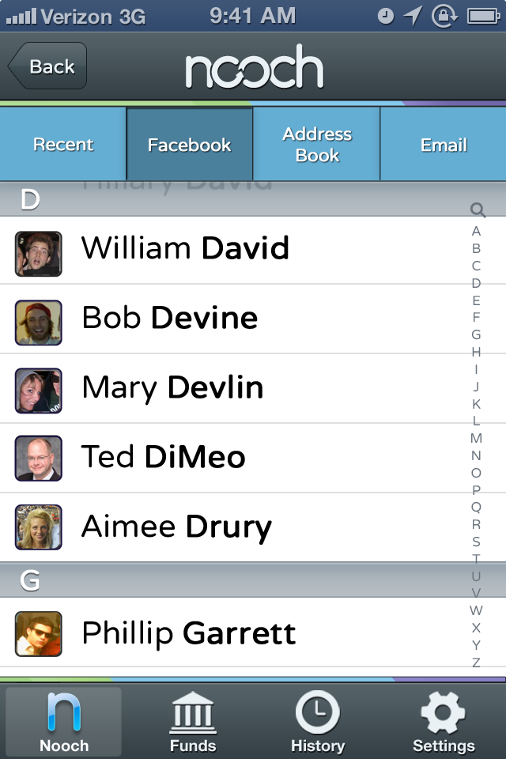

Slide 15
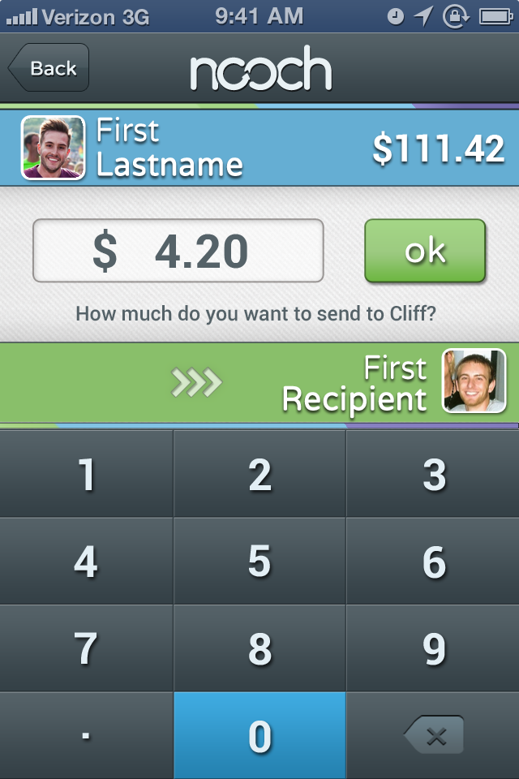

Slide 16
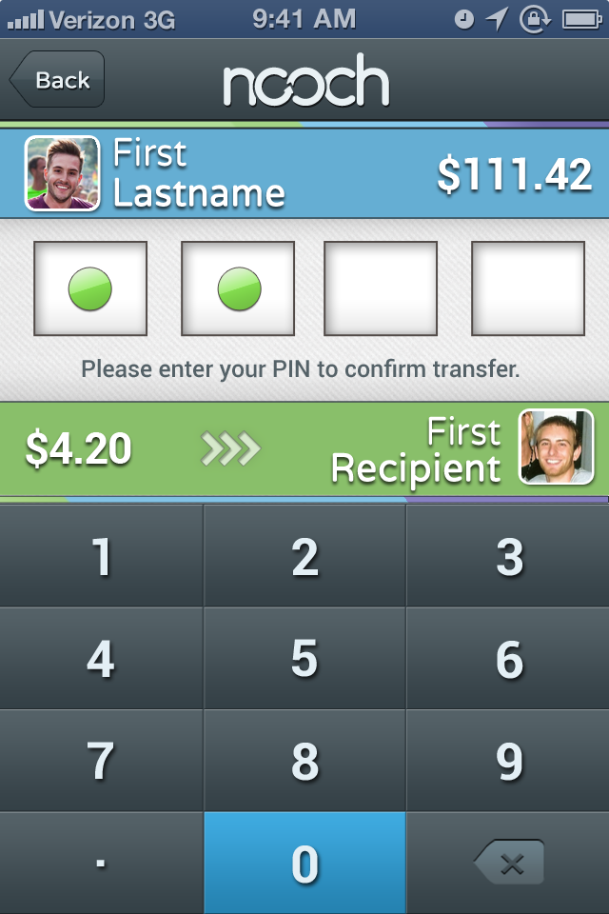

Slide 17
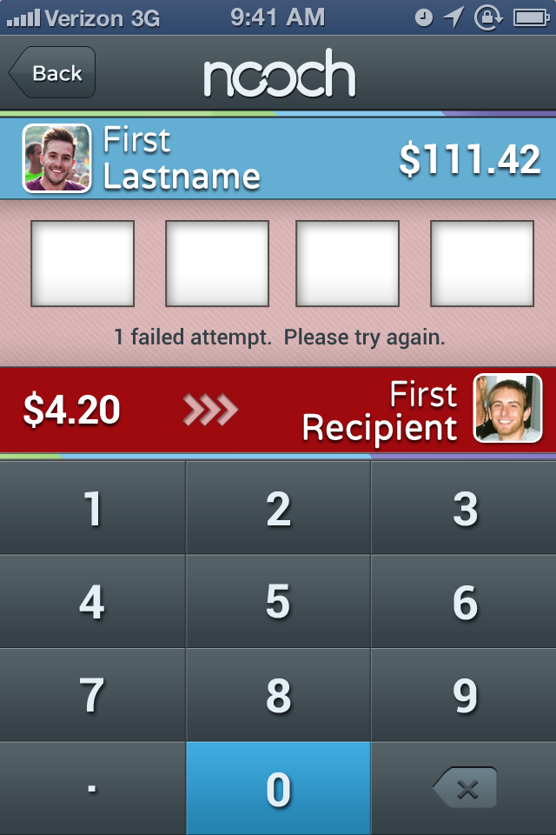

Slide 18
Funds Flow

Slide 19
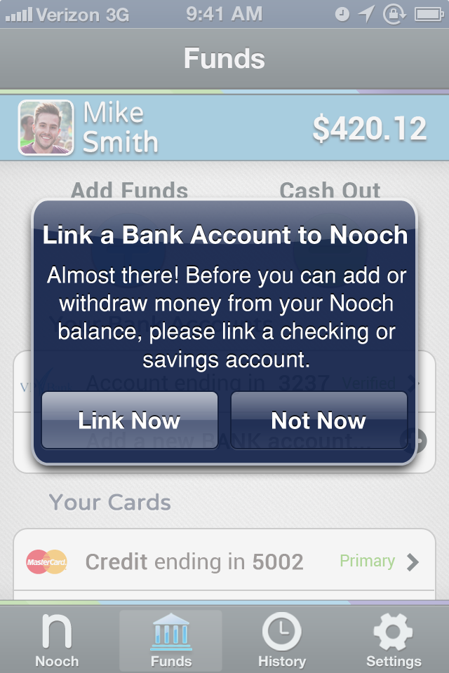
Display this prompt if the user has NOT already linked a bank account.
“Link Now” button goes directly to the “Add a bank account” screen.

Slide 20
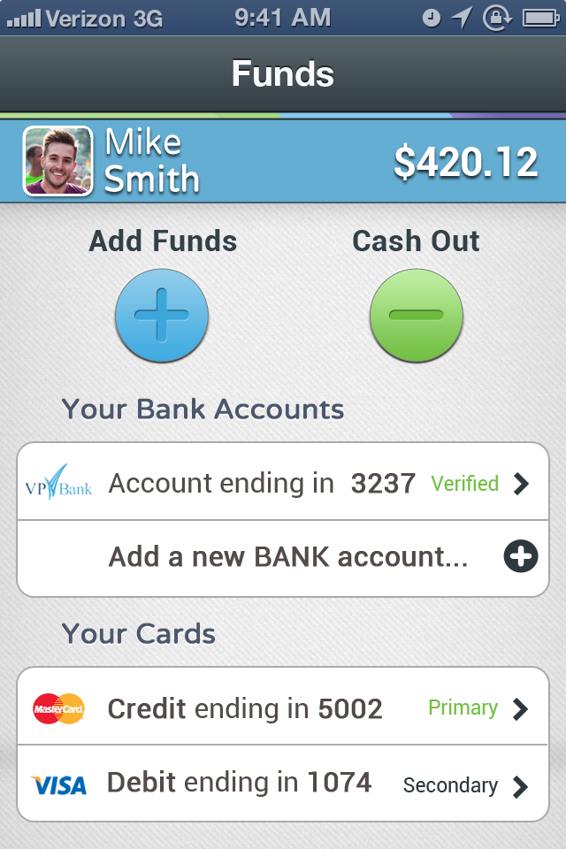
Varela Round, size 7, Bold
Roboto, size 5, regular, green
Roboto, size 7, regular (#’s bold)
Roboto, size 7, bold)
Normally display Bottom Bar… not here on this slide in order to show detail of cards section

Slide 21
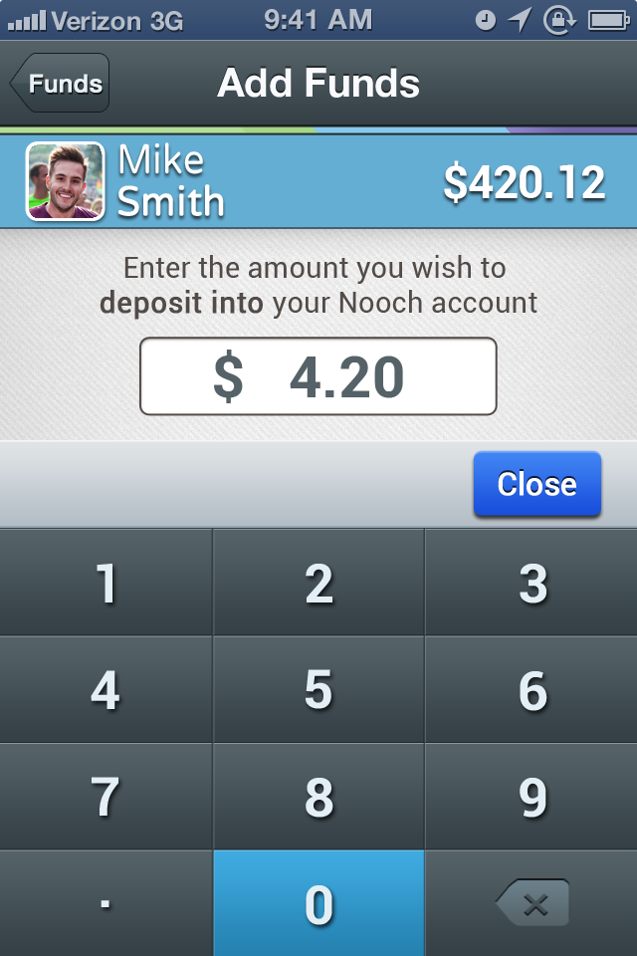
Roboto, size 6.5, regular
(Bold the words “deposit into”)
New “Close” button

Slide 22
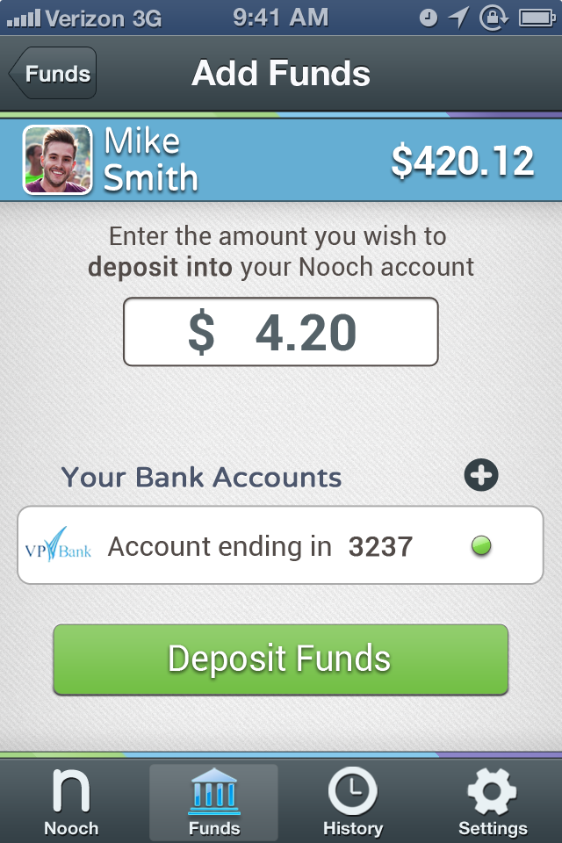
The green dot signifies which account is selected. Most users will only have 1 bank account, but if they have two, they can select which account to use by tapping the account.

Slide 23
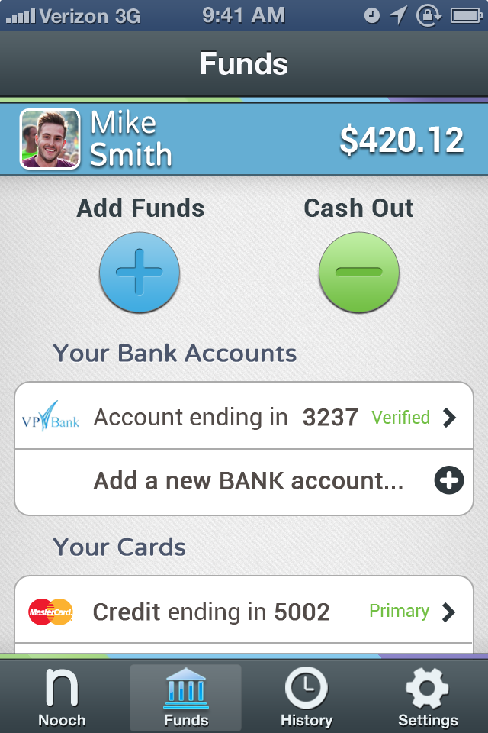

Slide 24
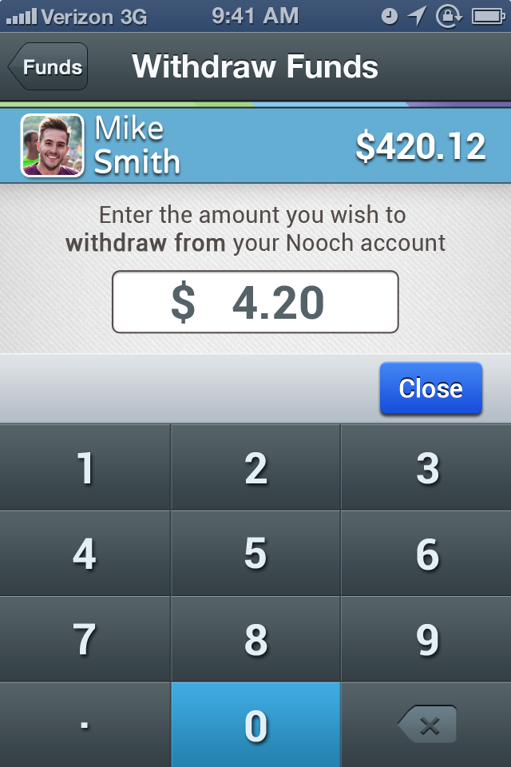
Roboto, size 6.5, regular
(Bold the words “withdraw from”)
New “Close” button

Slide 25
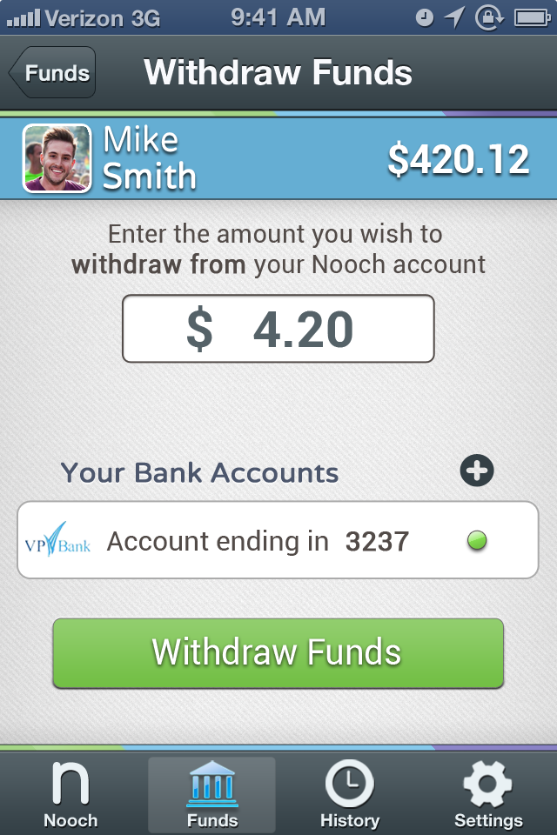
Varela Round, size 7, Bold
Roboto, size 7, bold

Slide 26
Varela Round, size 7, Bold
Roboto, size 7, regular (#’s bold)
Roboto, size 7, bold)

Slide 27
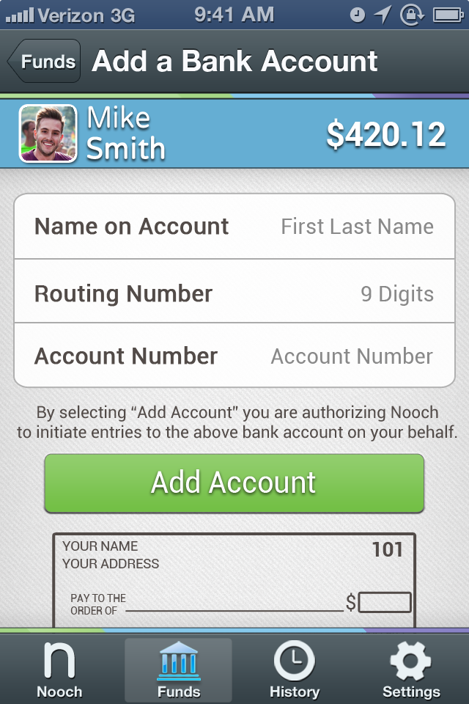
Roboto, size 6.5, regular
Color =
R: 36 G: 97 B: 127
Roboto, size 7, bold
The Routing number must be 9 digits
The account number must be between 4-17 numbers
Screen is scrollable to allow users to see the rest of the check image.

Slide 28
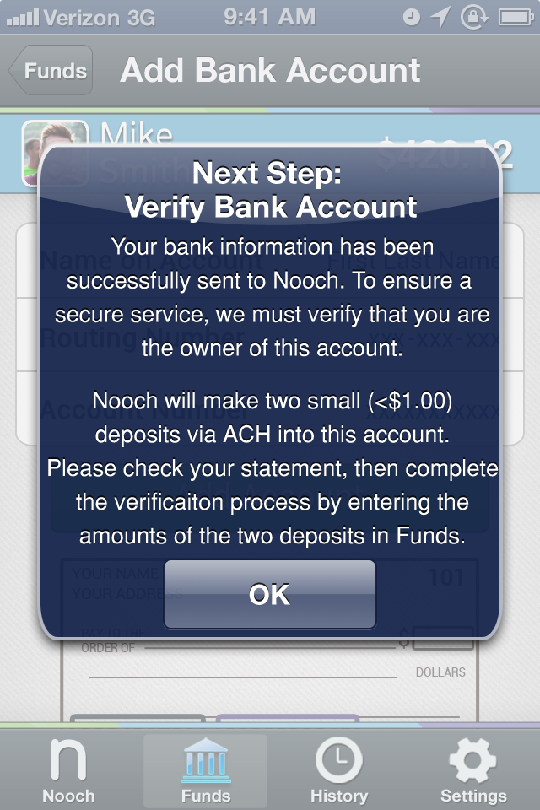

Slide 30
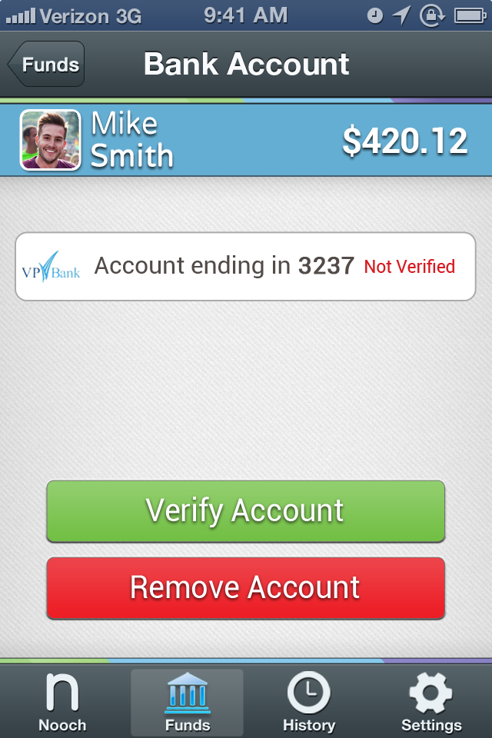
Roboto, size 4.5, Bold
Red or green text saying either “verified” or “not verified”
Roboto, size 7, bold
Green “Verify Account” button only appears when account is Not Verified. Once users verify successfully, this button should not appear.

Slide 31
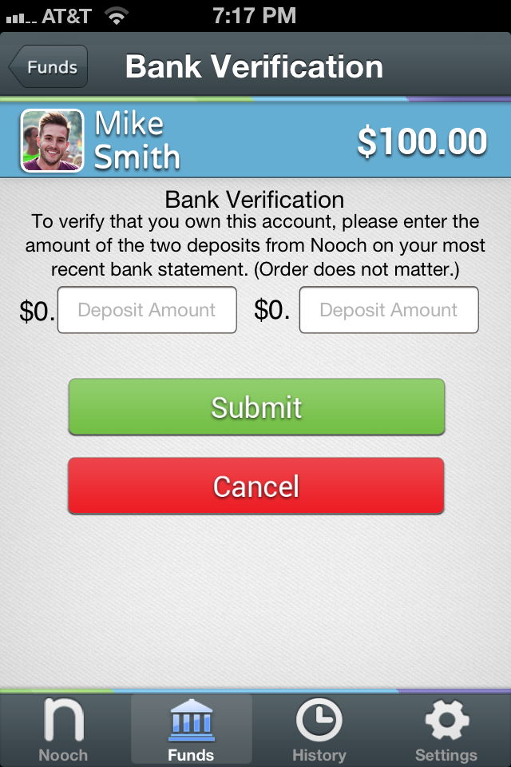

Slide 32
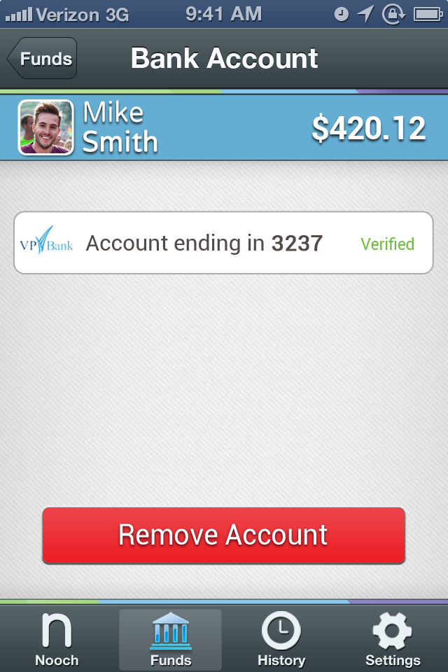

Slide 33
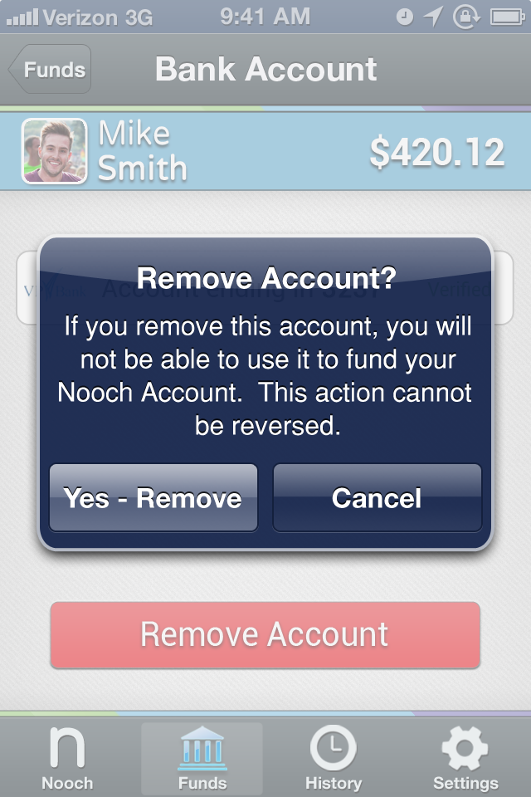

Slide 34
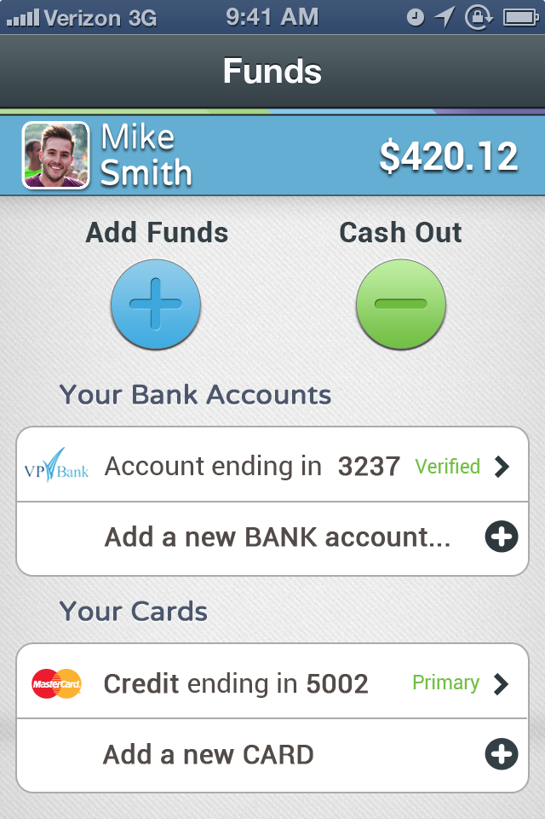
Varela Round, size 7, Bold
Roboto, size 7, bold

Slide 35
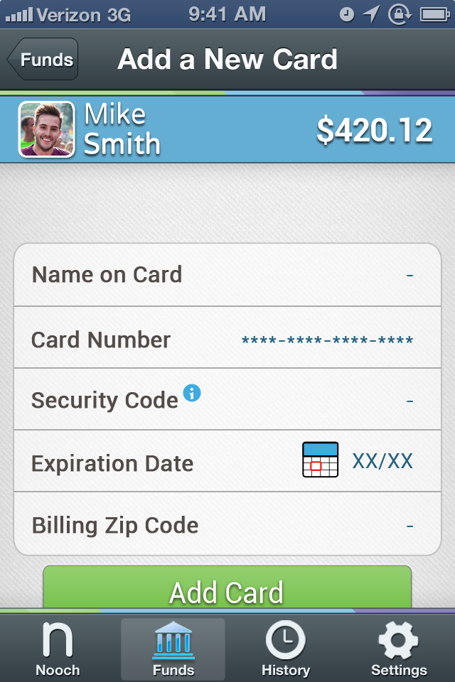
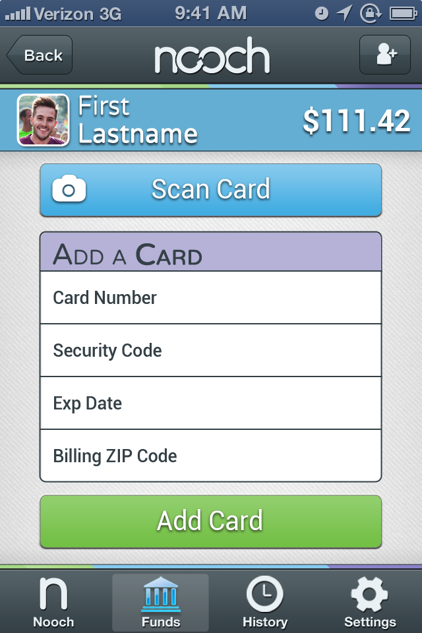
Calls Card.io API
New Field: Name on Card

Slide 37
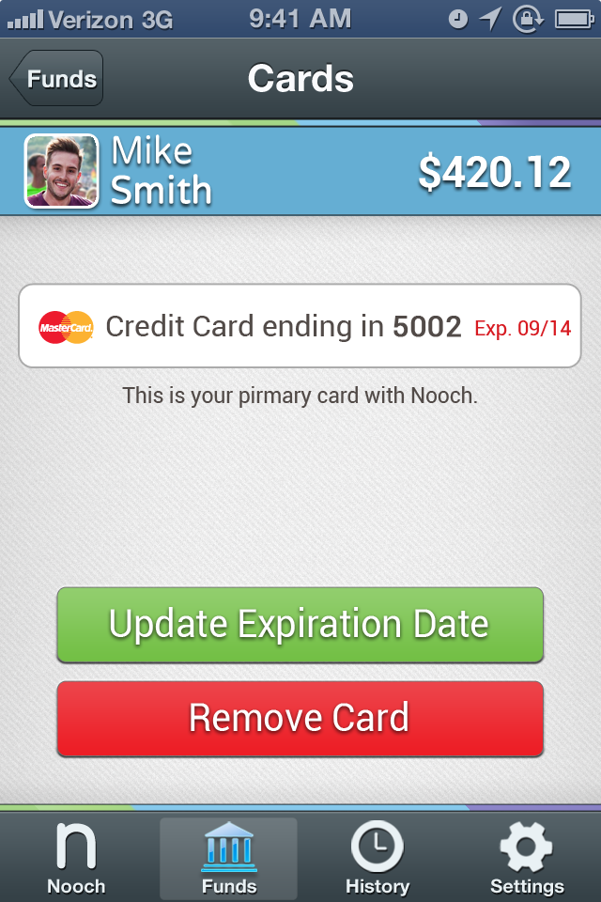
Update Exp. Date button pulls up same ratchet style menu as the Add Card screen’s calendar icon, with month and year.

Slide 38
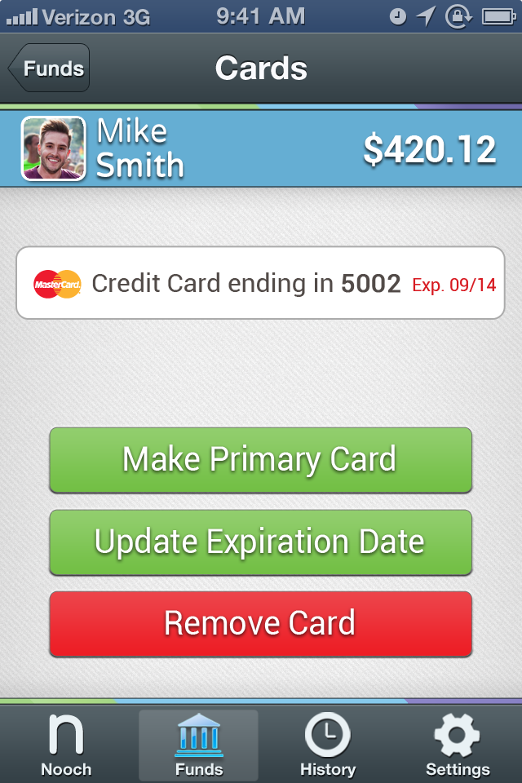

Slide 39
History Flow

Slide 40
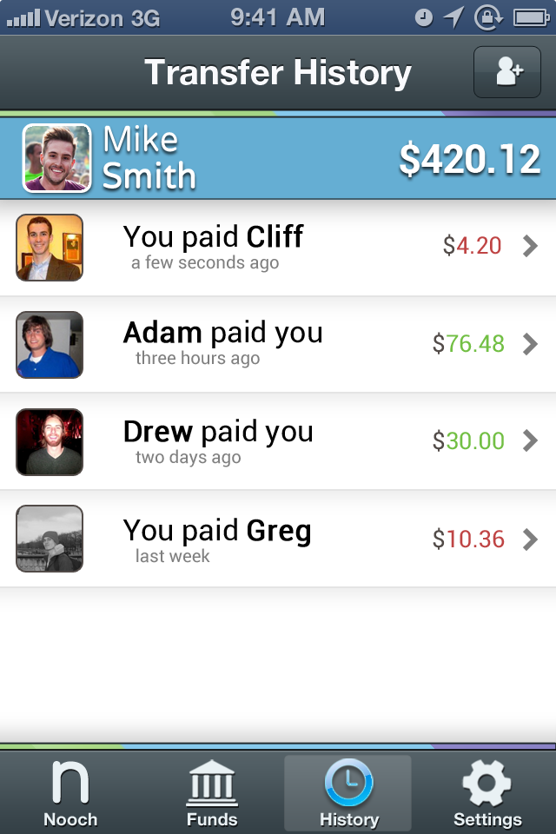
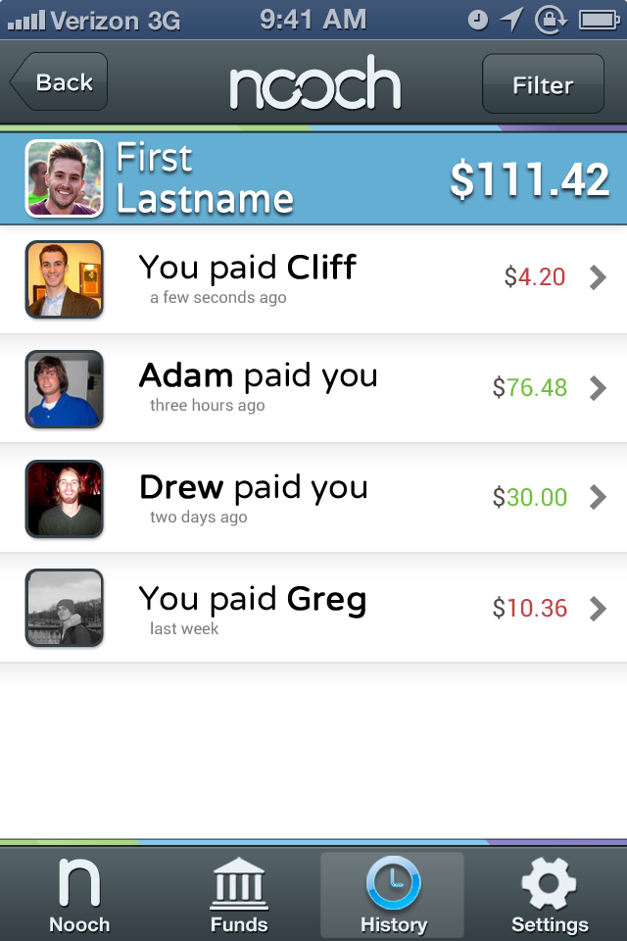
Filter button: call up ratchet menu as the app already does.
Font: Roboto, size 7.5, regular (Names bold), color = black
Font: Roboto, size 6, regular, Color =
Red or green
Font: Roboto, size 4.5, regular, Color =
R:127 G:127 B:127

Slide 41
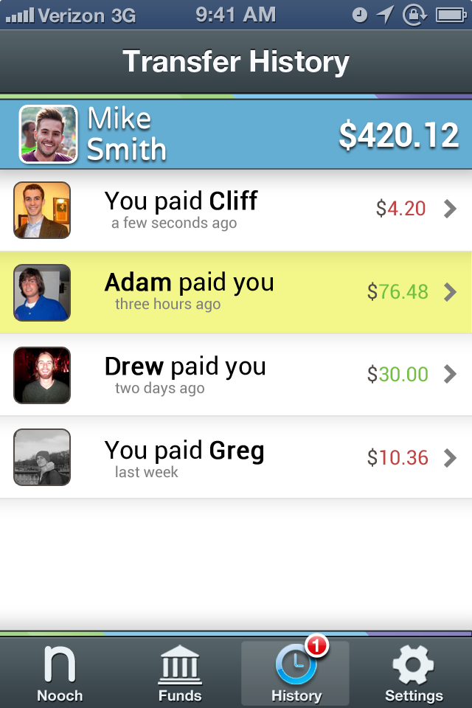
Filter button: call up ratchet menu as the app already does.
Yellow highlight to indicate which specific transfer the notification refers to. Yellow bar is
filled 100%
50% opacity
solid Color =
R: 231 G: 239 B: 22

Slide 42
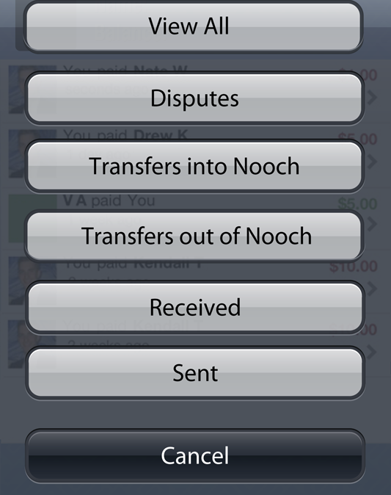

Slide 44
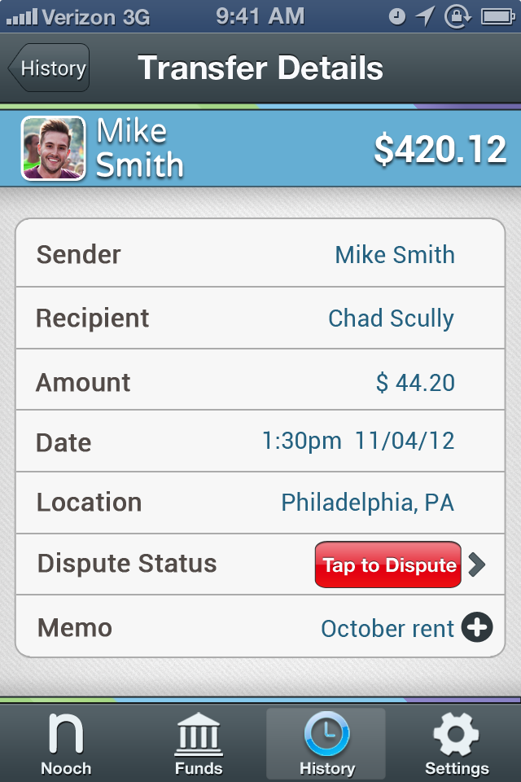
The Sender could be Nooch (for withdrawals our of Nooch), the user (for sent Nooch’s), or another user (for received Nooch’s)
…Ditto “Recipient”

Slide 45
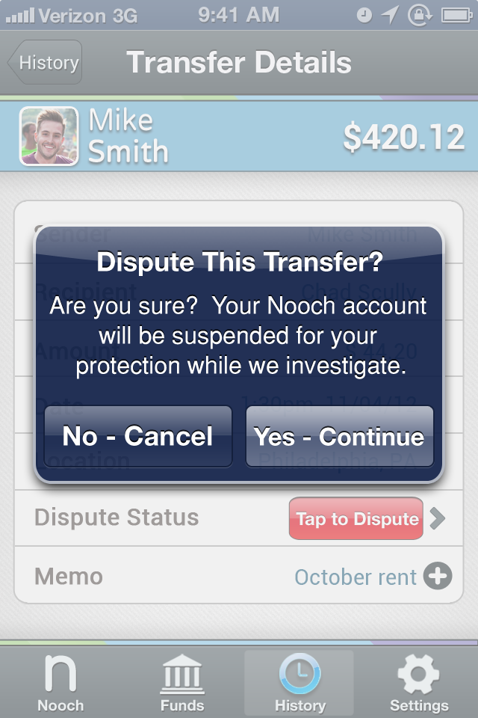
New Text

Slide 46
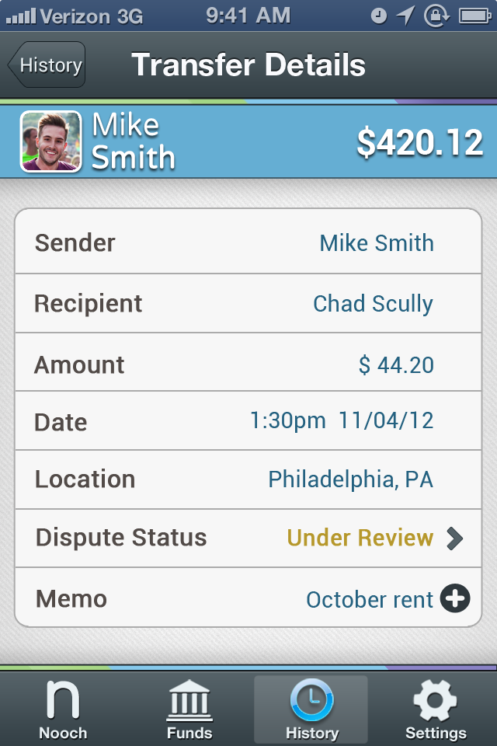
When Disputed & Under Review:
Font: Roboto, sz 6.5, bold
Color =
R: 182 G: 152 B: 44
The Red “Dispute Transfer” button should NOT appear once a user has disputed the transfer.

Slide 47
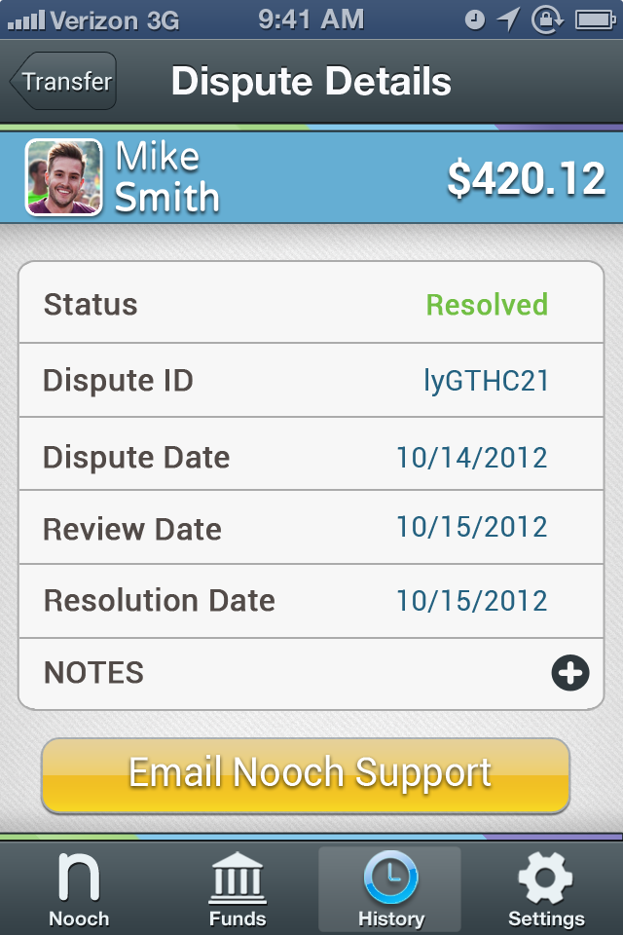
Font: Roboto, size 6.5, bold
Color =
R: 114 G: 191 B: 68
Roboto, size 9, regular

Slide 48
Settings Flow

Slide 49
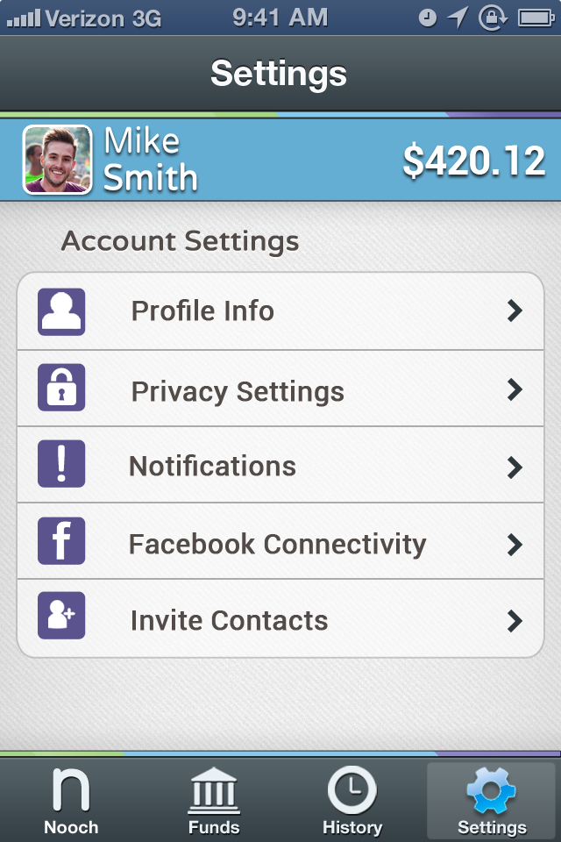
Varela Round, size 7, Bold
Roboto, size 7, bold

Slide 50
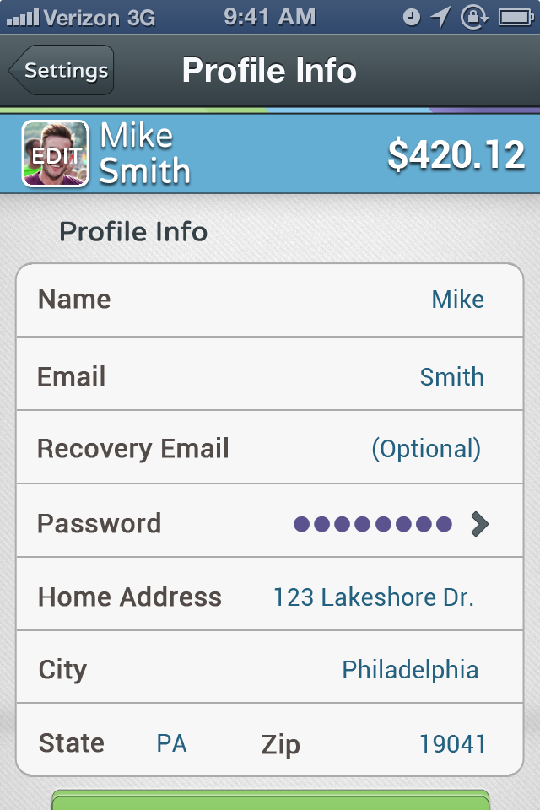
Varela Round, size 7, Bold
Roboto, size 6.5, regular.
Text color =
R: 36 G: 97 B:128
Roboto, size 7, bold

Slide 51
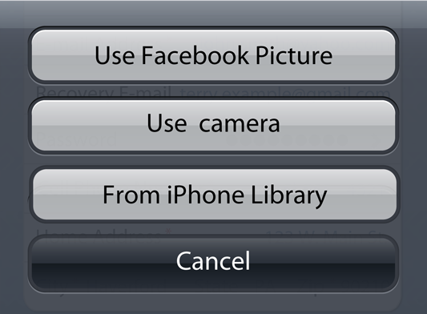

Slide 53
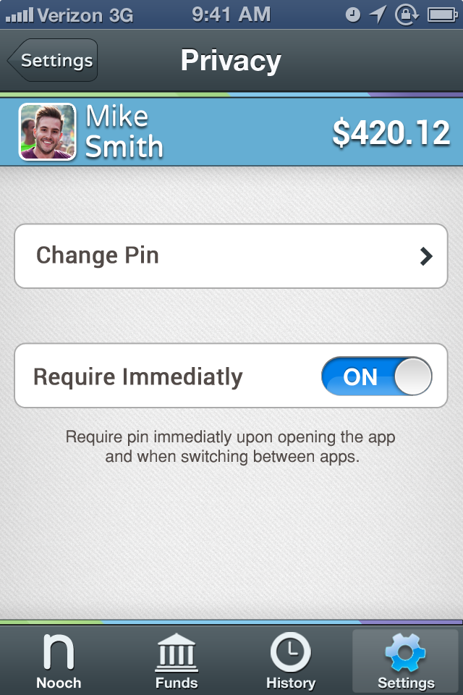
Roboto, size 7, bold
Roboto, size 5, regular.

Slide 54
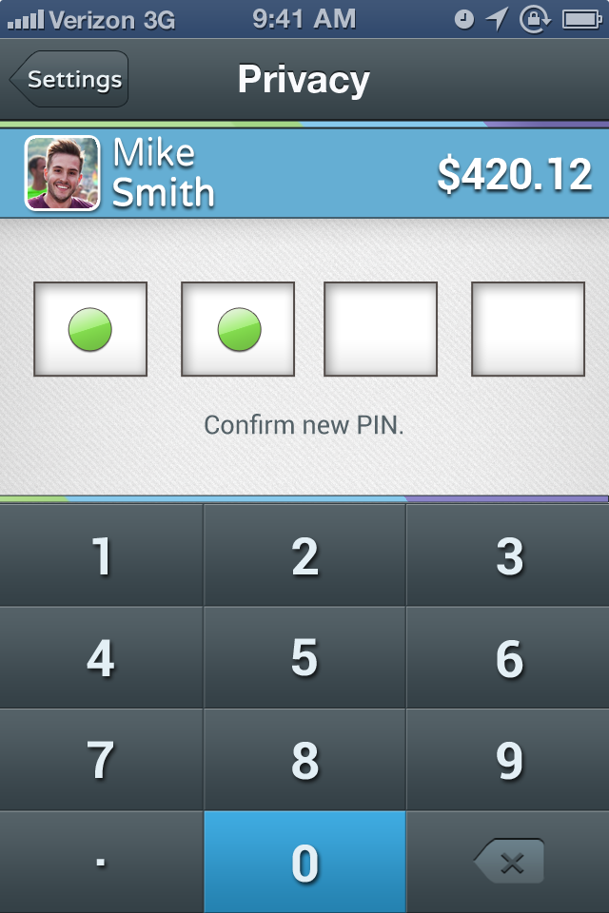
Roboto, size 6, regular

Slide 56
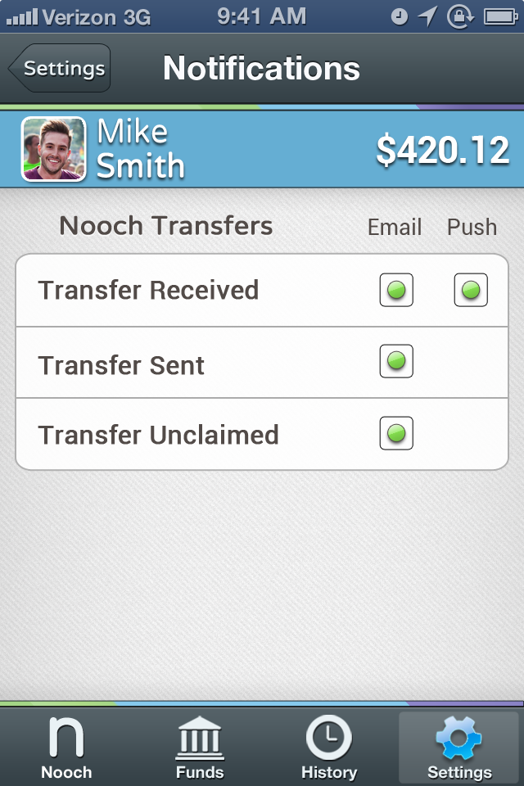
Roboto, size 6, regular

Slide 57
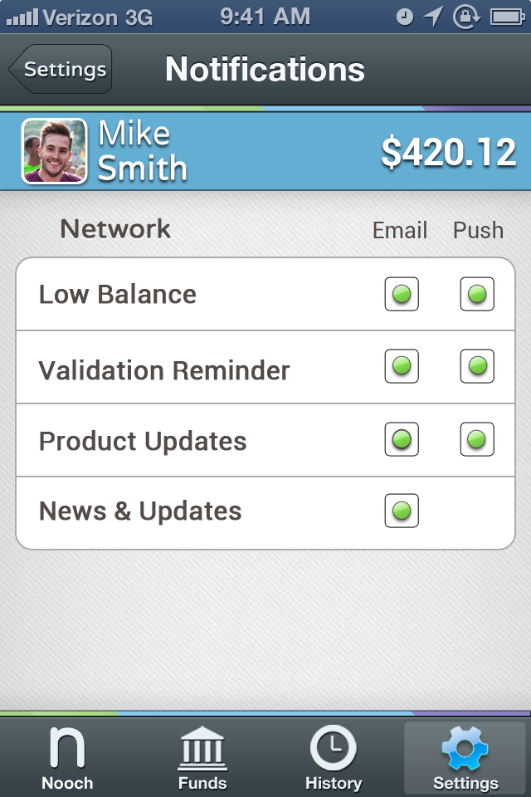

Slide 58
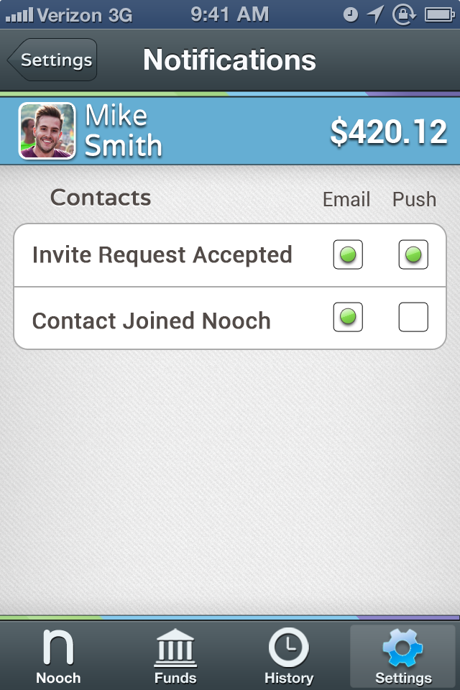

Slide 59
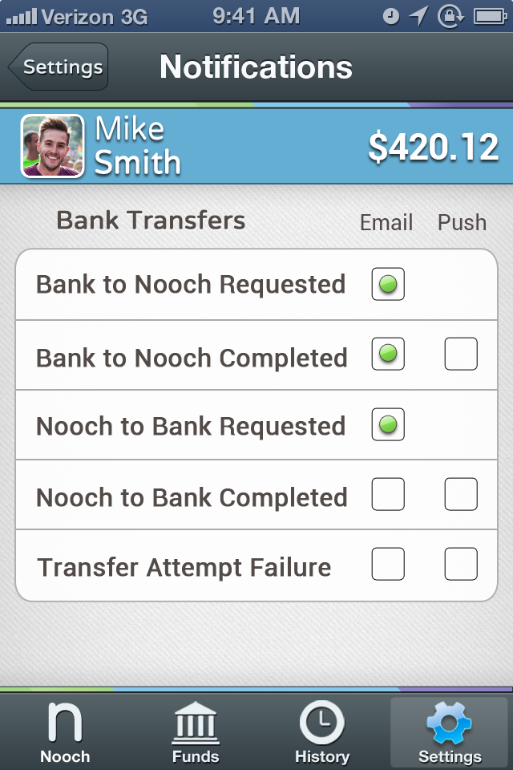

Slide 61

Roboto, size 5, regular

Slide 62

Roboto, size 5, regular

Slide 63


Slide 64


